Slide 1

How (not) to build a Trusted Path?
Aritra Dhar

Slide 2
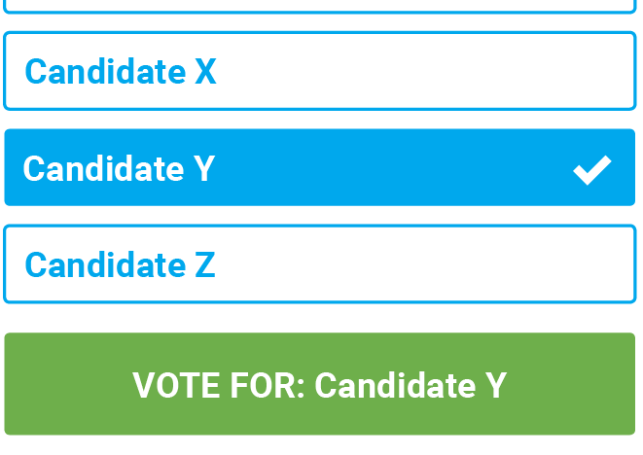
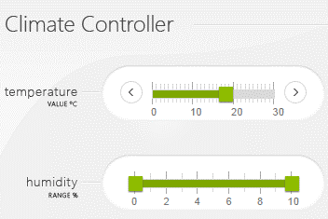
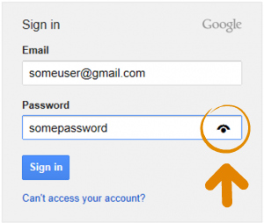
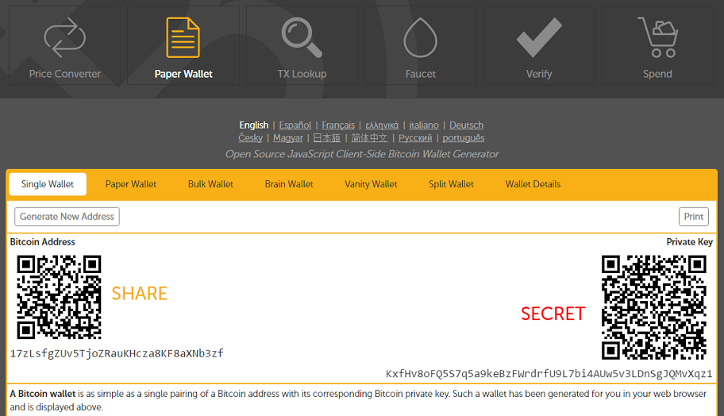
Motivation

Slide 3
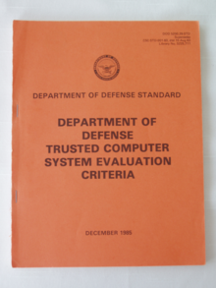
Definition
The TCB shall support a trusted communication path between itself and user for initial login and authentication. Communications via this path shall be initiated exclusively by a user.
- Trusted Computer System Evaluation Criteria (TCSEC) by US DoD (1985)

Slide 4








What is Trusted Path
TEE
IO driver
User
HIDs
Host
Remote server

Slide 5
Trust Assumption
Compromised platform
OS, applications, hardware…
Compromised network
Remote server is trusted

Slide 6
General Approach
Root-of-trust
External to the platform
Isolation
Put user into the loop

Slide 7
How to Build Trusted Path?
Transaction confirmation devices
Uni-directional trusted path (UTP)
Trusted intermediators
Hypervisor
Overshadow, SGXIO
External trusted hardware
Fidelius, IntegriKey
System TEE
Vbutton, TruZ-Droid

Slide 8
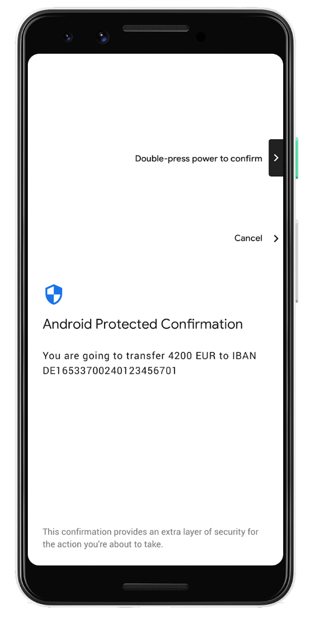
Transaction Confirmation Devices
Simple to develop
Easy to use for end-users
Widely deployed

Slide 9
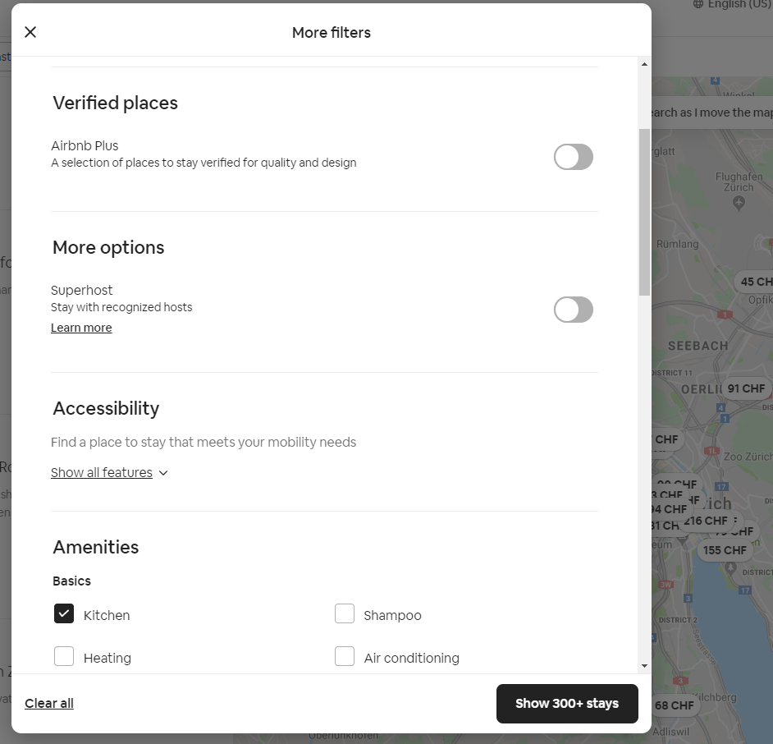
Transaction Confirmation Devices: What is bad about it?
Error of Habituation
Usability
Limited to text-based input

Slide 10
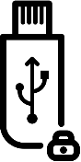







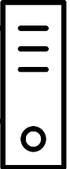
External Devices - IntegriKey
Keystroke
Trusted embedded device
Keyboard
Forwarded
keystroke
Keystroke via
Secure channel
Application-level
payload
Input trace match
Compromised host
Remote server

Slide 11
IntegriKey - Attack
100
100
10
0
1000
100
User sees 100
Device records 1000
Host sends 1000

Slide 12
Observation 1
The lack of output integrity – the render of user inputs on the screen – compromises input integrity.

Slide 13
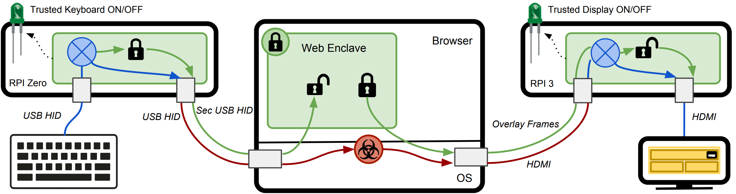
Fidelius – Output Integrity

Slide 14
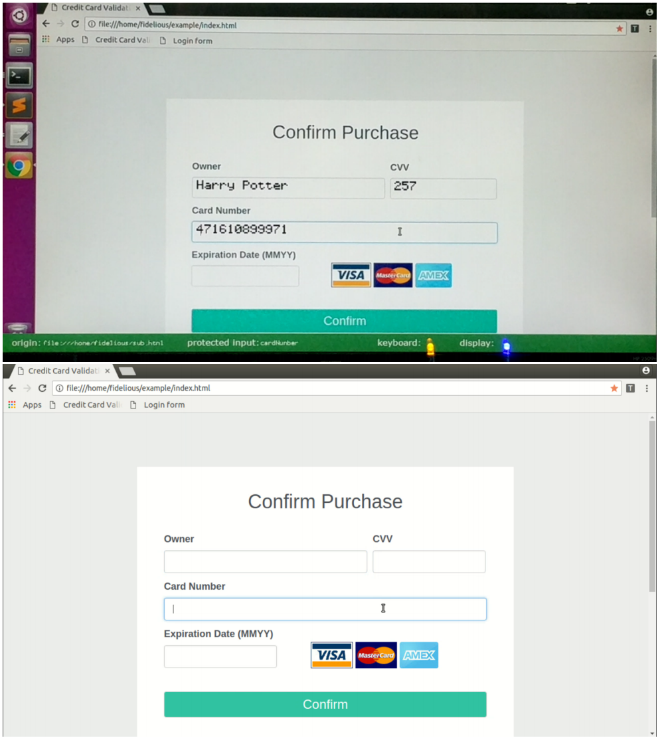
Output Integrity

Slide 15
Fidelius : Attack 1
The labels are not protected
Uses 3 security indicators
Security indicator does not work in real-world scenarios

Slide 16
Observation 2
If the protected output is provided out-of-context, users are more likely not to verify it. Therefore input integrity can be violated.

Slide 17
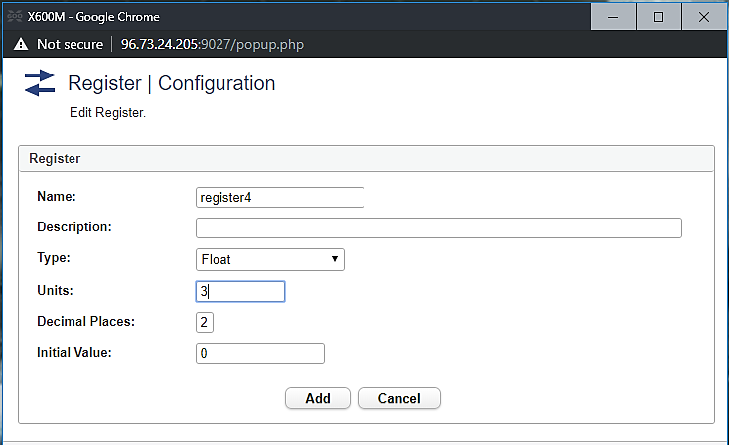
Fidelius: Attack 2
Early form submission attack
Textbox in focus
OS triggers click

Slide 18
Observation 3
If not all the modalities of inputs are secured simultaneously, none of them can be fully secured.

Slide 19
Requirements of Security and Functional Properties
R1. Inter-dependency between input and output
R2. Inter-dependency between all input modalities
R3a. No cognitive load for IO integrity
R3b. User attention for IO confidentiality
R4. Small trust assumptions and deployability

Slide 20
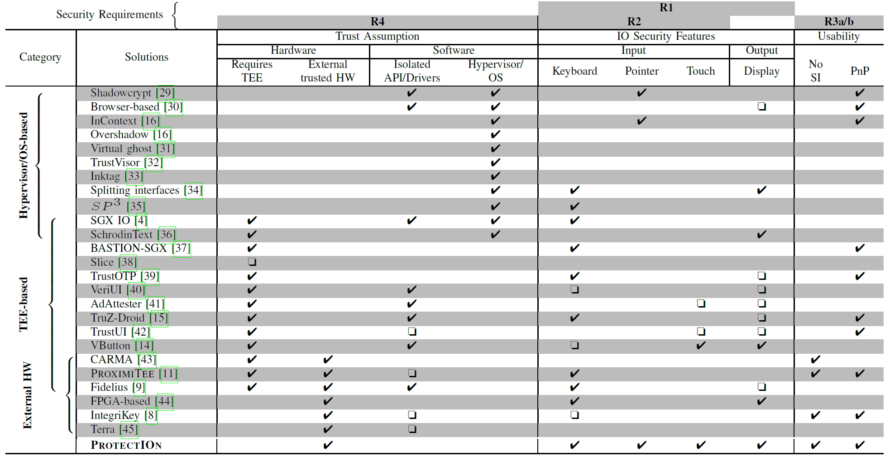
Other Trusted Path Solutions

Slide 21
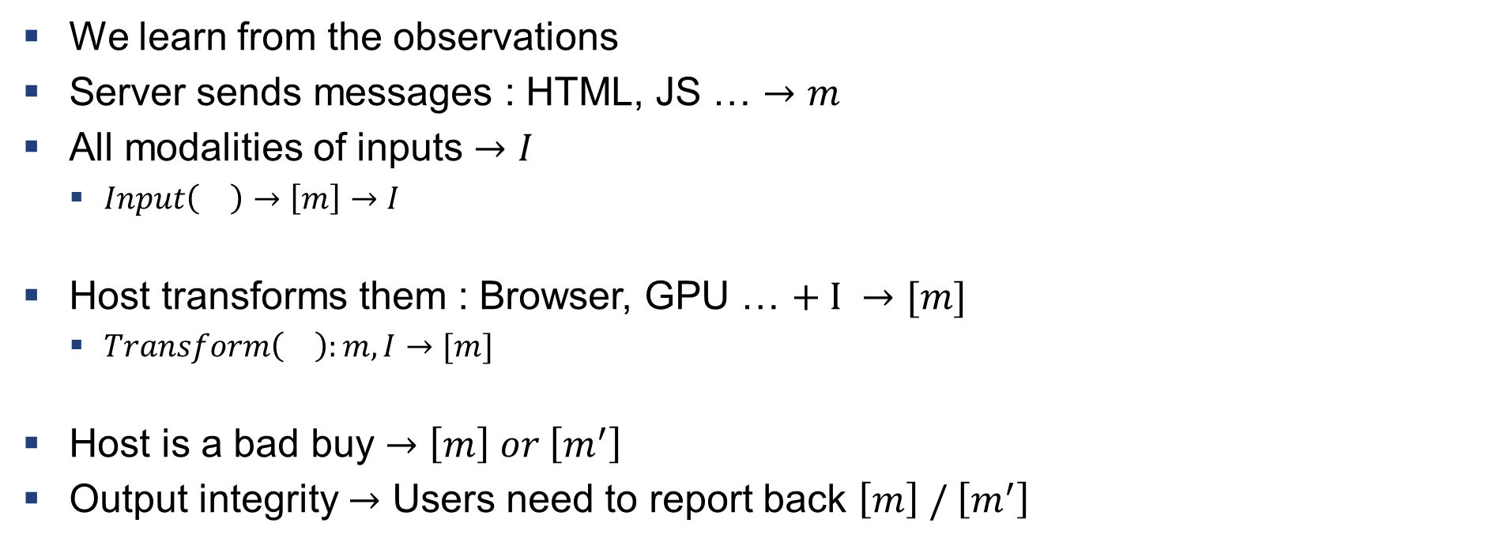
How to Build a Trusted Path
We learn from the observations
Server sends messages : HTML, JS … $→m$
All modalities of inputs $→I$
$Input\left(\right)→\left[m\right]→I$
Host transforms them : Browser, GPU … $+ I →[m]$
$Transform\left(\right):m,I→[m]$
Host is a bad buy $→\left[m\right] or \left[m^{′}\right]$
Output integrity $→$ Users need to report back $\left[m\right] / \left[m^{′}\right]$

Slide 22
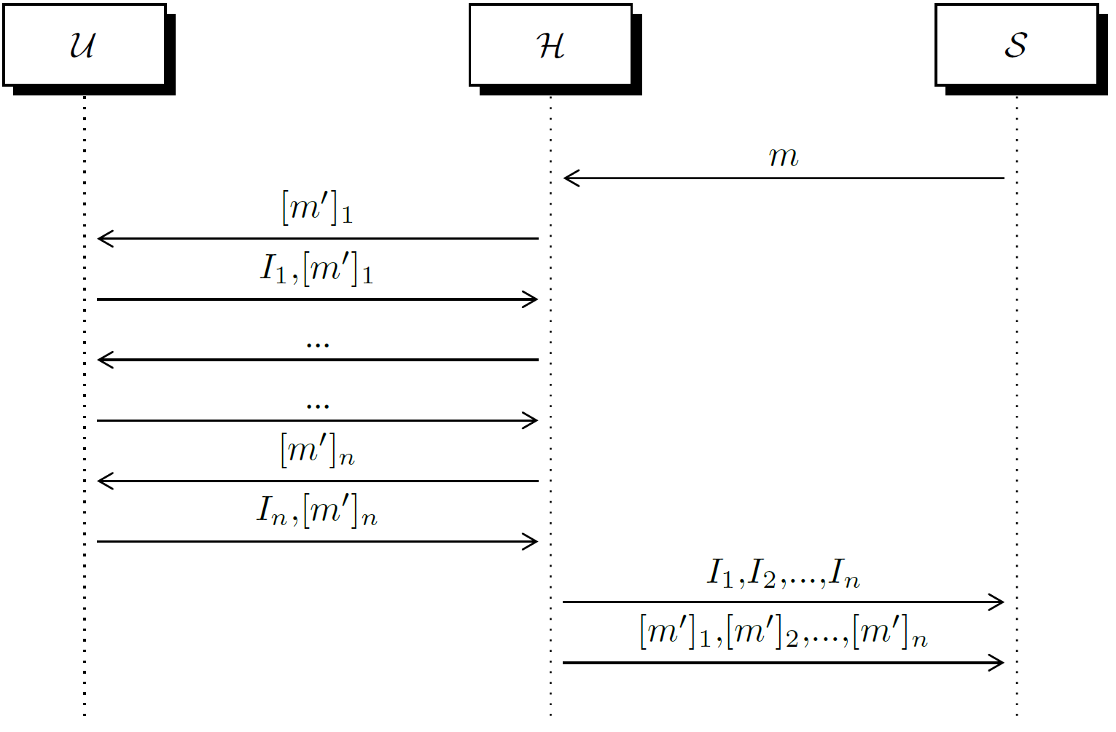
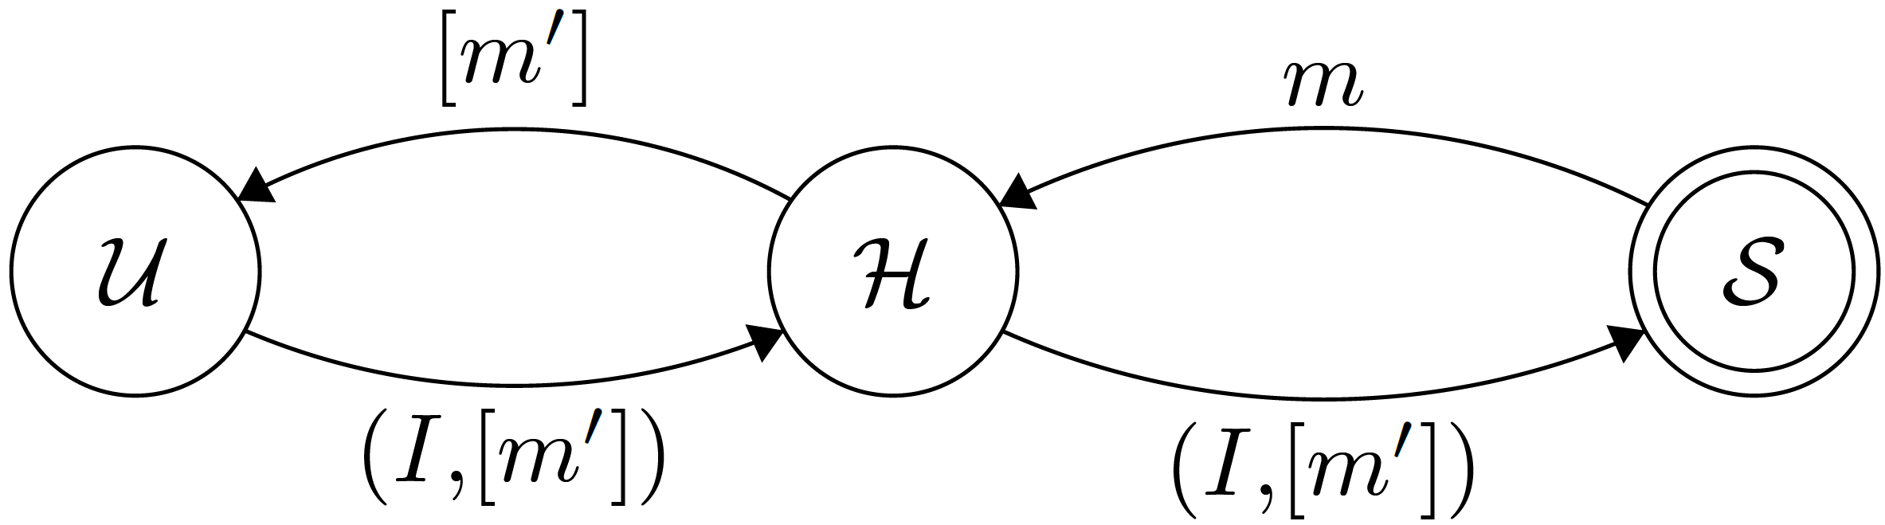
Trusted Path Interactions

Slide 23

Definition: Violation of Input/output Integrity
Sever sends $m$
Server knows $\left[m\right]$
Given $\left[m\right]$, correct input is $I$
Host sends $\left[m^{′}\right]≠\left[m\right]$ Output integrity
User sends $I^{′}≠I$ Input integrity

Slide 24
















Verification
$$m$$
$$Transform()$$
$${\left[m\right]}_{1}$$
$${\left[m\right]}_{2}$$
$${\left[m\right]}_{3}$$
$${\left[m\right]}_{i−1}$$
$${\left[m\right]}_{i}$$
$$I_{1}$$
$$I_{2}$$
$$I_{3}$$
$$I_{i−1}$$
$$I_{i}$$
$$…$$
$$Transform()$$
$$Transform()$$
$$Transform()$$
Anything missing in the chain $→$ IO integrity violation

Slide 25
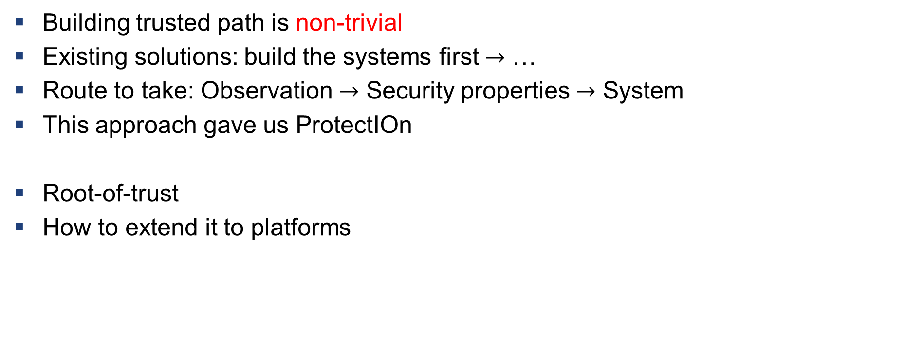
What we learnt?
Building trusted path is non-trivial
Existing solutions: build the systems first $→$ …
Route to take: Observation $→$ Security properties $→$ System
This approach gave us ProtectIOn
Root-of-trust
How to extend it to platforms

Slide 26
What is Missing
TEEs: Intel SGX, RISC-V keystone, ARM TrustZone, AMD SEV,…
Trusted path is still a problem
Hypervisor or external hardware
Exclusive/restrict access to peripheral
“I want my UBS app to have exclusive access to my keyboard.”
Peripherals are oblivious to the applications
Keyboard: “Am I getting accessed by the UBS app or the OS?”
Metered peripheral access
“I want to charge the client based on the number of GPU cores used by the ML app.”

Slide 27
Platform Awareness
Assurance of the state of the platform
State: CPU + Peripherals
State is determined by the attestation
“I know that I am running a proper version of the enclave that is using a certified peripheral that is running a proper firmware.”

Slide 28

Platform Awareness: Trust Model
Trusted peripherals
Trusted processor
Trusted Security Monitor
Untrusted platform

Slide 29

Basic Building blocks
Application enclaves (AE)
Encapsulates application-specific logics
Controller enclave (CE)
Driver logic
Peripheral policies
Modified peripheral
Added small core or $μ$-controller

Slide 30
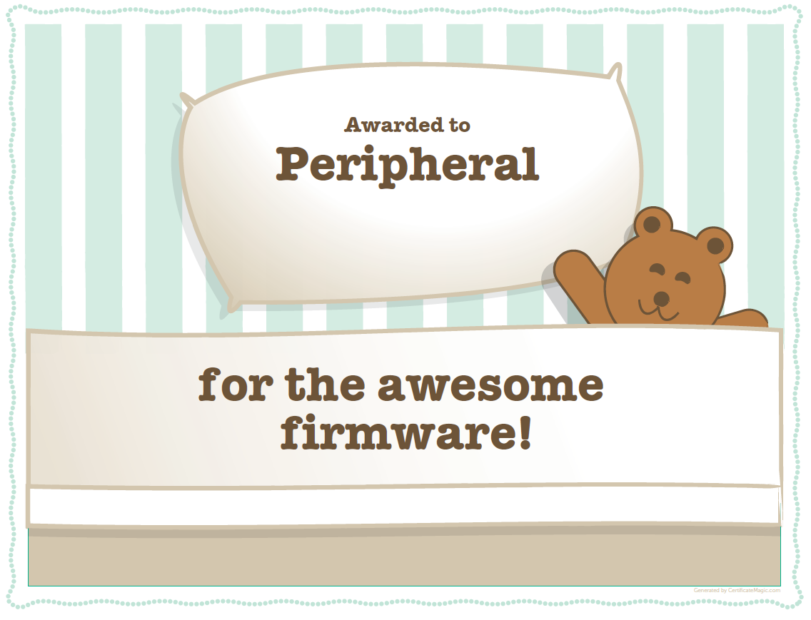
Basic Building Blocks
DSP
RISC-V Core
MEE
CE
AE
Signal
Key storage
Host CPU
Modified peripheral

Slide 31



Primitives
Communication through shared memory
Peripherals are either DMA or memory-mapped
Attestation
AE
CE
Peripherals
Slave
Master
Slave
Master
Slave
Master
$$E_{1}$$
$$E_{2}$$
…
$$E_{n}$$

Slide 32
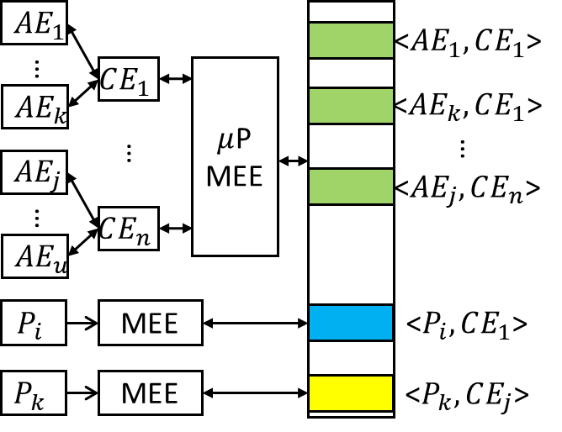
Architecture

Slide 33
Attestation
Keystone attestation
AE
CE
P
AE
CE
P
SM
SM

Slide 35


